Slide 1
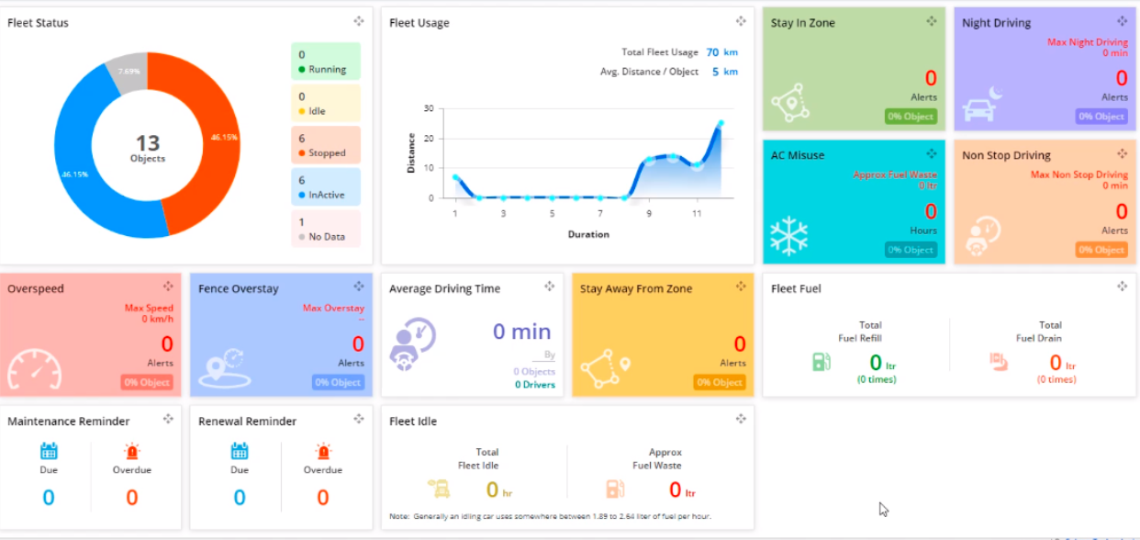

Slide 2




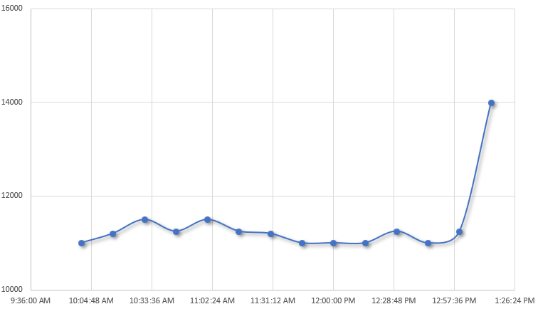
Download Report
Download O&M Manual
LIFT POSITION
OIL TEMPERATURE
Installation Info:
Drive model:
Drive continuous rating:
Output speed:
Electric Motor Rake: Electric Motor Lift:
Drive SN:
End User: Installation:
Process:
Basin Size (diameter):
In Service Since:
S25-AE-L524F
14,000 ft-lbs
0.06
1 HP
1 HP 123G678
Paper Mill of the South Rome, GA, USA
Mud Thickening
Ø30ft
12/3/2019
ALARM
CUTOFF
LIFT ACTIVE
WATER IN OIL
LOW OIL
LOSS MOTION
75%
120 ◦F
14,000 FT-LBS
Alerts:
Maintenance Records
Today:
Oil Change Overdue (48 days)
Last 7 days:
Last Month:
10/26/20, 09:36
10/26/20, 08.54
Last 6 Months:
8/25/2020, 16:20
Main Gear
Lift Operation (Lower)
Lift Operation (Raise)
Alarm
Last oil change (main gear) Next oil change (main gear)
Last oil change (lift PU) Next oil change (lift PU)
Next Scheduled service:
DBS Warranty:
Last repair (INC #):
Parts Repaired:
10/6/2020 TBD
10/6/2020
4/6/2020 4/6/2020
Oil Change
Valid, Exp 12/3/2020
N/A
N/A

Slide 3
ADMIN

Slide 4

Dashboard Dark View Add Device User Management Logout
Name of Unit 1
Name of Unit 2
2nd Name of Unit 1
2nd Name of Unit 2
Online
No alerts
Offline
Alert title
Notes:
DASHBOARD NAVIGATION ADMIN SIDE

Slide 5

Dashboard Dark View Add Device Settings User Management Logout
Download Manual
Download Report
PANEL INDICATORS
TORQUE
TORQUE HISTORY
LOW OIL
WATER IN OIL
LOSS MOTION
TORQUE (FT-LBS)
75%
OIL TEMPERATURE
99.7 F
LIFT POSITION
TIMESTAMP (MIN)
3500.54 FT-LBS
Graph Settings
ALERTS
Today:
Oil change overdue (48 days)
Last 7 days:
Last month:
10/26/20, 09:36
10/26/20, 08.54
Last 6 months:
8/25/2020, 16:20
MAINTENANCE RECORDS
Last oil change (main gear): Next oil change (main gear):
Last oil change (lift PU): Next oil change (lift PU):
Next scheduled service:
DBS warranty:
Last repair (INC #):
Parts repaired:
INSTALLATION INFORMATION
Drive model:
Drive continuous rating:
Output speed:
Electric motor rake: Electric motor lift:
Drive SN:
End user: Installation:
Process:
Basin size (diameter):
In service since:
Main Gear
Lift Operation (Lower)
Lift Operation (Raise)
Alarm
10/6/2020 TBD
10/6/2020
4/6/2020 4/6/2020
Oil Change
Valid, Exp 12/3/2020
N/A
N/A
S25-AE-L524F
14,000 ft-lbs
0.06
1 HP
1 HP 123G678
Paper Mill of the South Rome, GA, USA
Mud Thickening
Ø30ft
12/3/2019
Full History
Edit
Edit
Notes:
ADMIN SIDE
for lift position
actual number not a %age
need to have min and max values next to bar diagrams
Download Manual & Download Report
why move them to the bottom corner?
Buttons
should all the other buttons be in blue rather than grey?
Addition of a Device Management button inside this window so that all the options available in the dashboard design can be edited/amended

Slide 6

Dashboard Dark View Add Device Settings Users Management Logout
Name of unit 1
Name of unit 1
Units
Device Name
Name of unit 1
Graph
Device 2nd Name
2nd Name of unit 1
Device Management
Notes:
SETTINGS PAGE ADMIN SIDE FROM WITHIN THE DEVICE PAGE

Slide 7
Dashboard Dark View Add Device Settings Users Management Logout
Name of unit 1
Name of unit 1
Units
°C
Temperature:
°C °F
Graph
ft-lbs
Torque:
Nm ft-lbs
Device Management
psi
Pressure:
bar psi Pa
in
Distance:
mm in
12H
Time:
12H 24H
Time Zone:
(UTC -5) Eastern Standard Time
Notes:
SETTINGS PAGE ADMIN SIDE FROM WITHIN THE DEVICE PAGE
add time-zone

Slide 8
Dashboard Dark View Add Device Settings Users Management Logout
Name of unit 1
Name of unit 1
Horizontal lines
Units
Line Name:
ALARM
Line Value:
27,000 ft-lbs
Graph
Line Name:
CUTOFF
Line Value:
35,000 ft-lbs
+
Plot Markers
Display Plot Markers
Display Plot Markers Legend
Notes:
SETTINGS PAGE ADMIN SIDE FROM WITHIN THE DEVICE PAGE

Slide 9
Dashboard Dark View Add Device Settings Users Management Logout
Name of unit 1
Name of unit 1
Horizontal lines
Units
Line Name:
ALARM
Line Value:
27,000 ft-lbs
Graph
Device Management
Line Name:
CUTOFF
Line Value:
35,000 ft-lbs
+
Plot Markers
✔️
Display Plot Markers
Display Plot Markers Legend
✔️
✔️
Alarm
Cutoff
✔️
✔️
Lift Lower
Lift Raise
Loss Motion
Notes:
SETTINGS PAGE ADMIN SIDE FROM WITHIN THE DEVICE PAGE
the checkable options will increase in the future as the board and devices become more flexible.

Slide 10
Dashboard Dark View Add Device Settings Users Management Logout
Name of unit 1
Name of unit 1
Panel indicators
Units
Name:
Water in Oil
Type:
Light
Graph
Device Management
Name:
Low Oil
Type:
Light
Name:
Loss Motion
Type:
Light
Name:
Lift Position
Type:
Bar
Name:
Temperature
Type:
Meter
+
Notes:
SETTINGS PAGE ADMIN SIDE FROM WITHIN THE DEVICE PAGE

Slide 11
Dashboard Dark View Add Device Settings Users Management Logout
Name of unit 1
Name of unit 1
Label Name:
Water in Oil
Type:
Light
Panel indicators
Units
Name:
Water in Oil
Type:
Light
Graph
Channel of Reference:
Water in oil
Device Management
Name:
Low Oil
Type:
Light
Standard Condition:
OFF
Name:
Loss Motion
Type:
Light
Changing condition:
≥
1
Name:
Lift Position
Type:
Bar
Name:
Temperature
Type:
Meter
+
OK
Notes:
SETTINGS PAGE ADMIN SIDE FROM WITHIN THE DEVICE PAGE - pop-up when generating lights, bars, meters after clicking “+” sign or pencil
Light selection/Creation - the menu changes with the selection of a different indicator. - 2 different examples
Standard Condition options: ON/OFF
Channel of Reference: List Based (channels names from board) - Torque/Temperature/Loss Motion/Water in Oil/ others
Changing condition
window 1: ≥/≤

Slide 12
Dashboard Dark View Add Device Settings Users Management Logout
Name of unit 1
Name of unit 1
Label Name:
Lift Position
Type:
Bar
Panel indicators
Units
Name:
Water in Oil
Type:
Light
Graph
Channel of Reference:
Lift Position
Device Management
Name:
Low Oil
Type:
Light
Min Value:
0
Max Value:
24
Name:
Loss Motion
Type:
Light
Display Units:
mm
Name:
Lift Position
Type:
Bar
Name:
Temperature
Type:
Meter
+
OK
Notes:
SETTINGS PAGE ADMIN SIDE FROM WITHIN THE DEVICE PAGE - pop-up when generating lights, bars, meters after clicking “+” sign or pencil
Light selection/Creation - the menu changes with the selection of a different indicator - 2 different examples.
Channel of Reference: List Based (channels names from board) - Torque/Temperature/Loss Motion/Water in Oil/ others
Min Value & Max Value - These are values that will be displayed on the side of the bar
Display units: should be able to pick from all units included in the units page.

Slide 13
Event based symbols for plot
As a standard, these will be included. Customer/User has the ability of removing them and not see them. A legend can also be added in the graph settings
In dashboard generation ADMIN will determine which will be present in the dashboard based on the units’ design.
List of symbols (there should be an option to add new in the future)
= alarm
= cutoff
= lift lower
= lift raise
= loss motion
A
C

Slide 14
USER

Slide 15
Dashboard Dark View Settings Logout
Name of Unit 1
Name of Unit 1
Name of Unit 2
Name of Unit 2
2nd Name of Unit 1
2nd Name of Unit 2
Online
No alerts
Offline
Alert title
Online
No alerts
Offline
Alert title
Notes:
DASHBOARD NAVIGATION USER SIDE

Slide 16
Dashboard Dark View Settings Logout
Personal Settings
Personal
Name of unit 1
Name:
john doe
Name of unit 2
Position:
field technician
Contact Phone Number:
+1
555-555-5555
Email:
asdjsad@sdadas.com
Security
Password:
Notes:
SETTINGS PAGE USER SIDE FROM MAIN DASHBOARD HOME PAGE
admin can access this page from the user management page

Slide 17
Dashboard Dark View Settings Logout
Name of unit 1
Personal
Name of unit 1
Device Name
Name of unit 1
Units
Device 2nd Name
2nd Name of unit 1
Graph
Name of unit 2
Notes:
SETTINGS PAGE USER SIDE FROM MAIN DASHBOARD HOME PAGE

Slide 18
Dashboard Dark View Settings Logout
Name of unit 1
Personal
°C
Name of unit 1
Temperature:
°C °F
Units
ft-lbs
Torque:
Nm ft-lbs
Graph
psi
Pressure:
bar psi Pa
Name of unit 2
in
Distance:
mm in
12H
Time:
12H 24H
Time Zone:
(UTC -5) Eastern Standard Time
Notes:
SETTINGS PAGE USER SIDE FROM MAIN DASHBOARD HOME PAGE

Slide 19
Dashboard Dark View Settings Logout
Name of unit 1
Personal
Horizontal lines
Name of unit 1
Line Name:
ALARM
Line Value:
27,000 ft-lbs
Units
Line Name:
CUTOFF
Line Value:
35,000 ft-lbs
Graph
Name of unit 2
+
Plot Markers
Display Plot Markers
Display Plot Markers Legend
Notes:
SETTINGS PAGE USER SIDE FROM MAIN DASHBOARD HOME PAGE

Slide 20
Dashboard Dark View Settings Logout
Name of unit 1
Personal
Horizontal lines
Horizontal lines
Name of unit 1
ALARM
ALARM
27,000 ft-lbs
Line Name:
27,000 ft-lbs
Line Name:
Line Value:
Line Value:
Units
CUTOFF
CUTOFF
35,000 ft-lbs
Line Name:
35,000 ft-lbs
Line Name:
Line Value:
Graph - Title
Line Value:
Name of unit 2
+
+
Plot Markers
Plot Markers
✔️
Display Plot Markers
Display Plot Markers
Display Plot Markers Legend
Display Plot Markers Legend
✔️
✔️
Alarm
Cutoff
✔️
✔️
Lift Lower
Lift Raise
Notes:
SETTINGS PAGE USER SIDE FROM MAIN DASHBOARD HOME PAGE
plot markers
user can only select from options made available from ADMIN based on unit type

Slide 21
Dashboard Dark View Settings Logout
Download Manual
Download Report
PANEL INDICATORS
TORQUE
TORQUE HISTORY
LOW OIL
WATER IN OIL
LOSS MOTION
TORQUE (FT-LBS)
75%
OIL TEMPERATURE
99.7 F
LIFT POSITION
TIMESTAMP (MIN)
3500.54 FT-LBS
Graph Settings
ALERTS
Today:
Oil change overdue (48 days)
Last 7 days:
Last month:
10/26/20, 09:36
10/26/20, 08.54
Last 6 months:
8/25/2020, 16:20
MAINTENANCE RECORDS
Last oil change (main gear): Next oil change (main gear):
Last oil change (lift PU): Next oil change (lift PU):
Next scheduled service:
DBS warranty:
Last repair (INC #):
Parts repaired:
INSTALLATION INFORMATION
Drive model:
Drive continuous rating:
Output speed:
Electric motor rake: Electric motor lift:
Drive SN:
End user: Installation:
Process:
Basin size (diameter):
In service since:
Main Gear
Lift Operation (Lower)
Lift Operation (Raise)
Alarm
10/6/2020 TBD
10/6/2020
4/6/2020 4/6/2020
Oil Change
Valid, Exp 12/3/2020
N/A
N/A
S25-AE-L524F
14,000 ft-lbs
0.06
1 HP
1 HP 123G678
Paper Mill of the South Rome, GA, USA
Mud Thickening
Ø30ft
12/3/2019
Full History
Edit
Notes:
USER SIDE

